Slide 1





ETH Quantum Hackathon Alice&Bob Challenge: Qubitli
Manuel Antoinette, Jan Jakob, Fabian Schatz
ETH, 11.05.2025

Slide 2

OUR FULL PIPELINE
Overview pipeline (Manuel)
Displacement strategy (Fabi) Fock states
Sampling strategy (radial sampling, etc) (why? Gradient, maxima, Minima)(Manuel)
Optimization (Jan)
Denoising strategy (Fabi)
Results
Noise analysis (Jan)

Slide 3
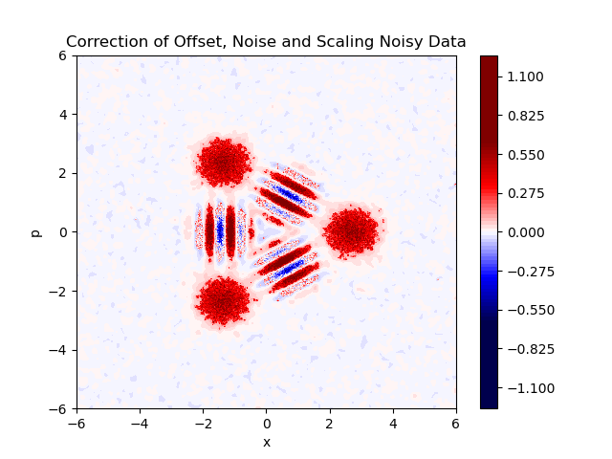
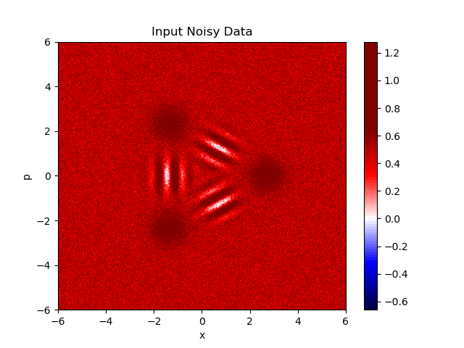
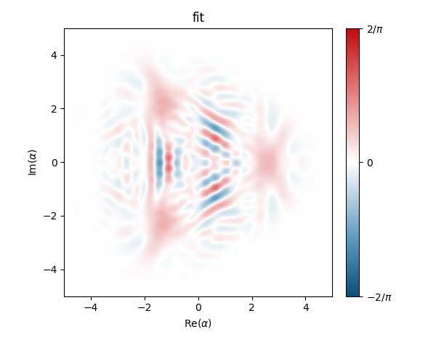
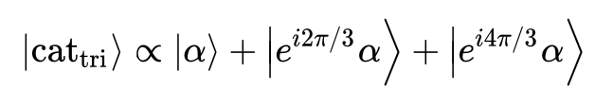
OVERVIEW

Slide 4
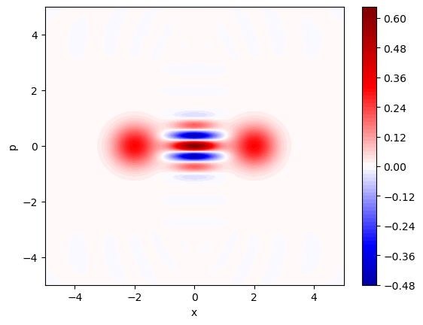
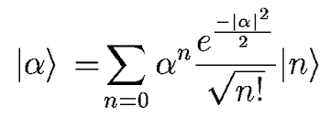
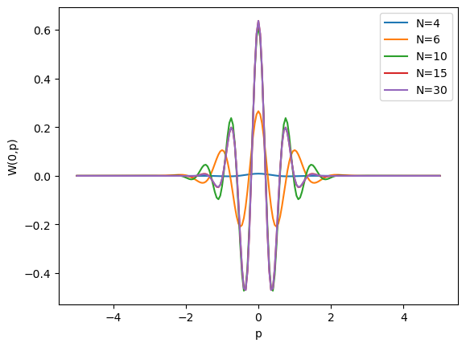
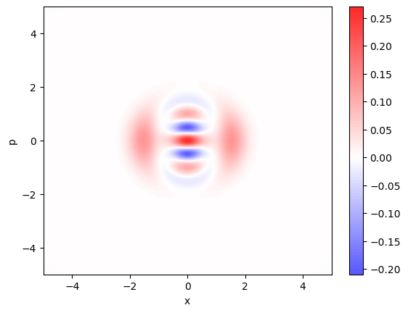
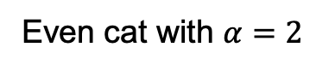
FOCK STATE TRUNCATION
Even cat with $α=2$
Fock state truncation
Approximation of states in terms of Fock states:
N=30
N=6

Slide 5
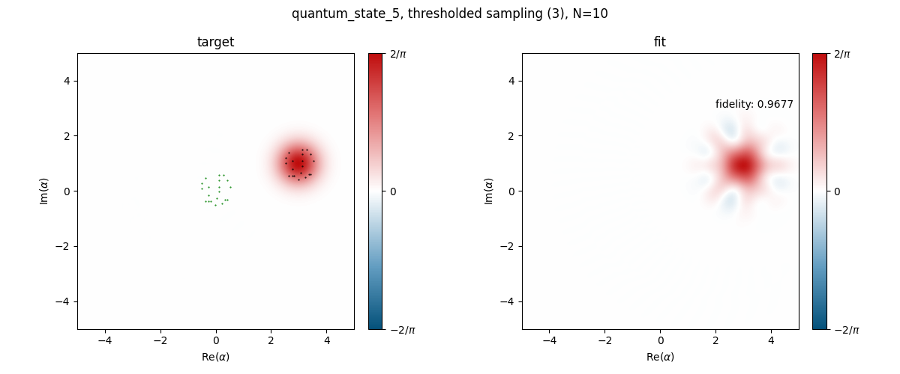
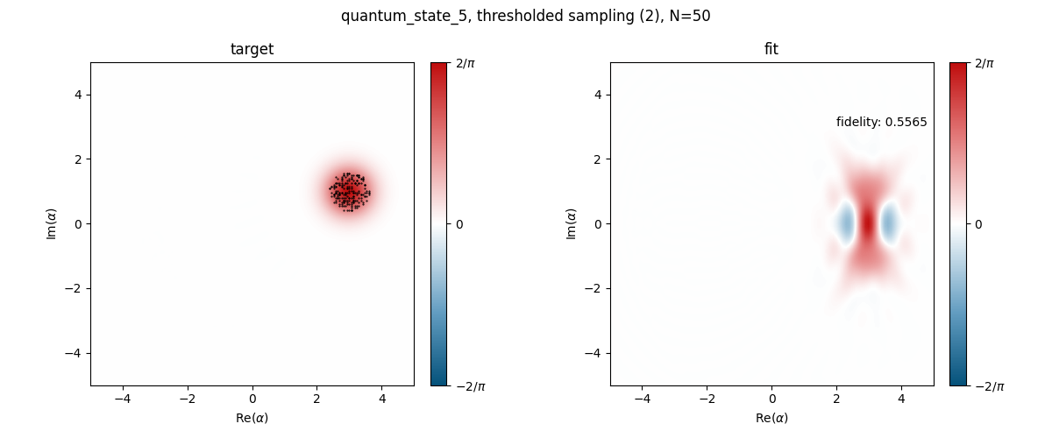
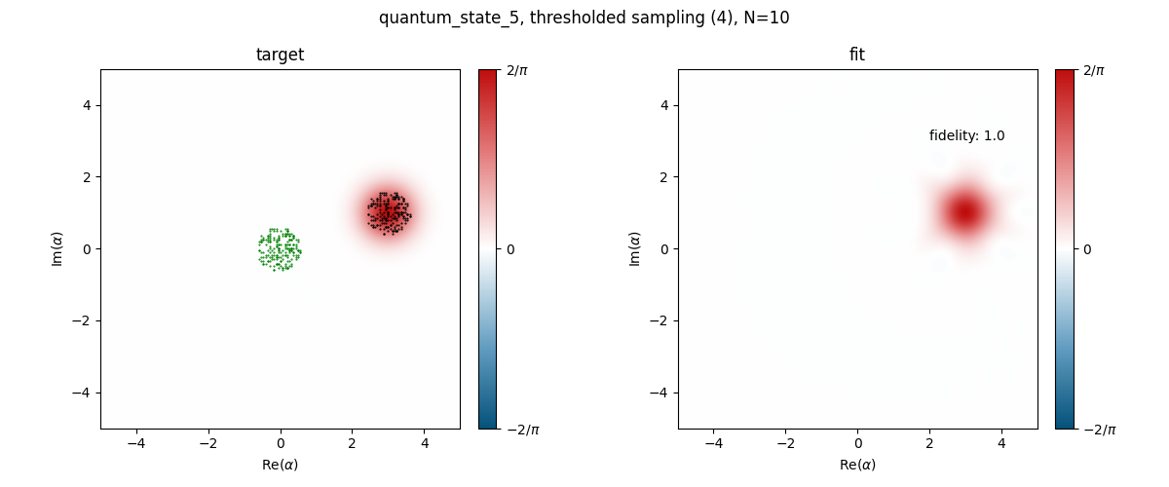
DISPLACEMENT STRATEGY

Slide 6
SAMPLING STRATEGY
Compare basic strategy grid sampling (show plot with rectangular sampling points) to strategy with advanced strategy
Points of interest: maxima (state is ”localized” there), minima (characterize quantum superposition), high gradients
Grid sampling doesn’t cover the points of interest the most efficient
Our approach: sampling from probability distribution function that takes into account the relevance of the points

Slide 7
OPTIMIZATION
Compare basic strategy grid sampling (show plot with rectangular sampling points) to strategy with advanced strategy

Slide 8
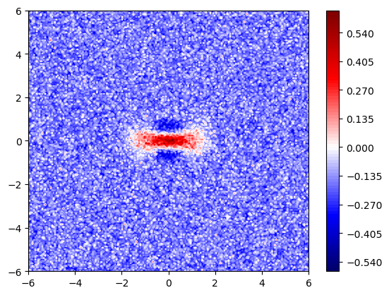
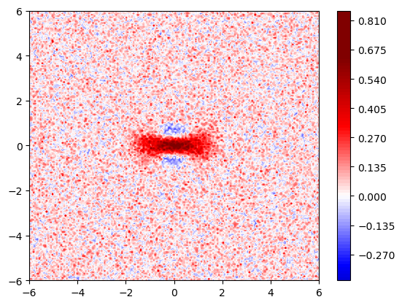
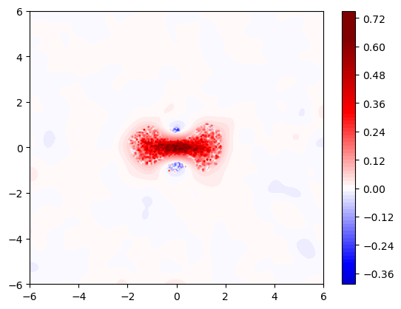
DENOISING STRATEGY
Choose regions with the least local variance
Average over all to get offset
Heavily smooth out the flat regions of low interest
Keep the important features

Slide 9
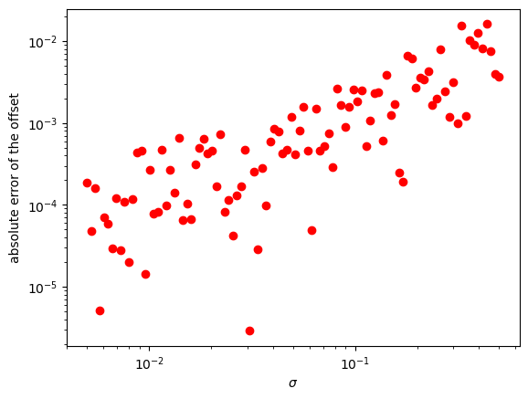
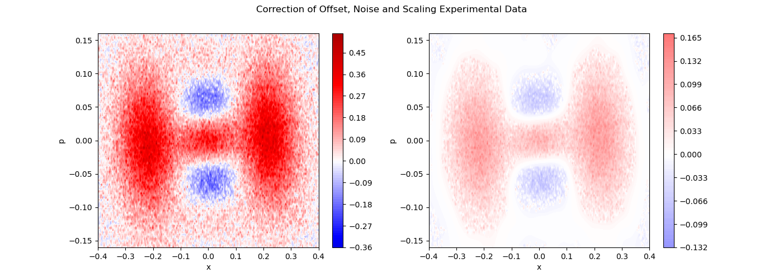
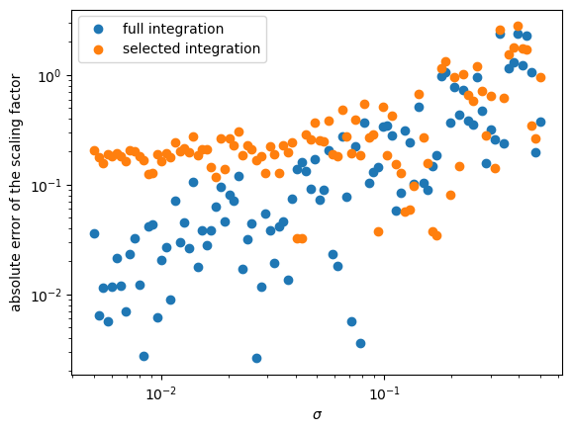
DENOISING & AFFINE TRAFO: Analysis
Real measurement example:

Slide 10
RESULTS
Compare basic strategy grid sampling (show plot with rectangular sampling points) to strategy with advanced strategy

Slide 11
EXPERIMENT NOISE ANALYSIS
Compare basic strategy grid sampling (show plot with rectangular sampling points) to strategy with advanced strategy

